Slide 1
Operating System
Dr. Kaushal Shah
Assistant Professor
Computer Engineering
PDEU
The compilation of the PPTs is from the source:
All the different articles and research papers available on internet and NPTEL

Slide 2
Outline for Today
Introduction to the Subject
Course Outcome
Syllabus

Slide 3
Always Remember
There are no “stupid” questions.
It is a waste of your time and the class’s time to proceed when you don’t understand the basic terms.
If you don’t understand it, someone else probably doesn’t, either.

Slide 4
CO
CO1- Describe concepts of process management for system performance improvement.
CO2- Explain synchronization problems.
CO3- Calculate turnaround time, waiting time and response time.
CO4- Perform Optimal memory utilization.
CO5- Compare between different Page replacement algorithms.
CO6- Apply suitable Approaches for process synchronization, Memory and file management.

Slide 5
Syllabus
UNIT 1 PROCESS MANAGEMENT
Introduction-Operating system, OS Operations, Process Management, Memory Management, Storage Management, Protection and Security, System calls, Process and Threads.
UNIT 2 SYNCHRONIZATION
Process Scheduling-Basic concepts and algorithms, Thread scheduling, Process Synchronization algorithms, Mutual exclusion, Test Set Locks, Semaphores-Binary, Counting.
UNIT 3 DEADLOCKS
Deadlocks- Deadlock Avoidance, Deadlock Detection, and Recovery from Deadlock.
UNIT 4 MEMORY AND FILE MANAGEMENT
Memory Management and Virtual Memory-Contiguous Memory Allocation, Segmentation, Paging. Virtual Memory Management - Background, Demand Paging, Copy-on-Write, Page Replacement, Page Replacement Algorithms, Allocation of Frames, Thrashing. Storage Management-File System- Concept of a File, System calls for file operations.

Slide 6
Operating System
What is an Operating System?
A program that acts as an intermediary between a user of a computer and the computer hardware.
What is the purpose of an operating system?
To provide an environment in which a user can execute programs.
What are the goals of an Operating System?
The primary goal of an Operating System is to make the computer system convenient to use.
The secondary goal is to make the computer system efficient to use.

Slide 7
Components of Computer Systems
Hardware – provides basic computing resources (CPU, memory, I/O devices).
Operating system – controls and coordinates the use of the hardware among the various application programs for the various users.
Applications programs – define the ways in which the system resources are used to solve the computing problems of the users (compilers, database systems, video games, business programs).
Users (people, machines, other computers).

Slide 8
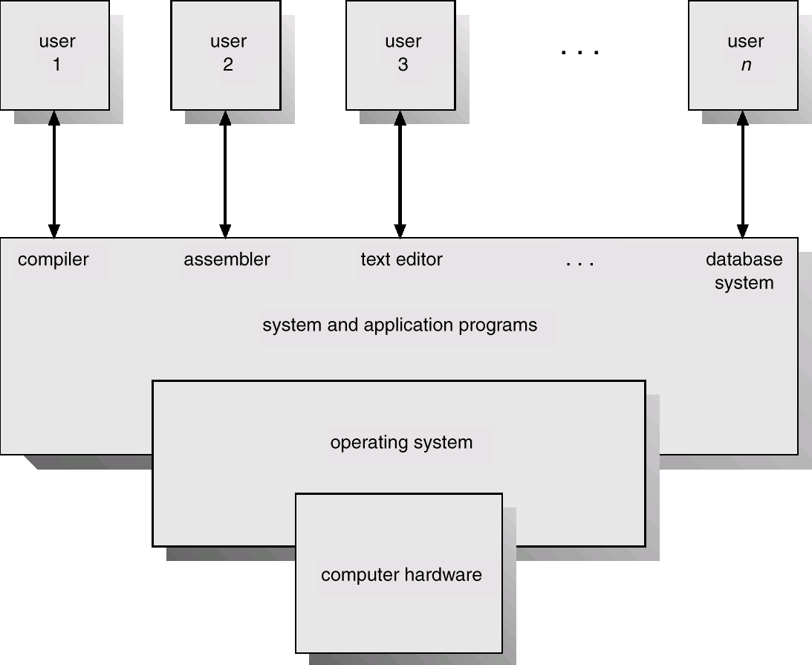
Abstract View of System Components

Slide 9
Function of Operating System
OS as Extended machine
Computer Architecture shows that computer is made up of chips and wires
We do not want to program on the bare metal
Virtual machine creates a hardware abstraction
Abstract machine can provide hardware independent interfaces
Increase portability
Allow greater protection
Implication is that it is much faster and easier to program with less errors

Slide 10
Function of Operating System
OS as resource manager
Coordination and control of limited resources such as memory, disk, network, etc
Deal with resource conflicts
Deal with resource fairness
Make access efficient as possible

Slide 11
Parts of OS
No universal agreement on the topic, but most likely
Memory Management
IO Management
CPU Scheduling
IPC
MultiTasking/Multiprogramming
(On some Operating System, this functionality is provided by a single program known as the kernel)

Slide 12
Parts of OS (Contd.)
What about?
File System
Multimedia Support
UI (X Windows, MSWin)
Internet Browser?
Why would extras be important

Slide 13
Questions???

